Slide 1

Infineon & Raspberry pi in IoT
Swarnam Panday (IFIN DES TCP EPE)
- restricted -

Slide 2
Agenda
1
IoT
2
Benefits & Architecture of IoT
3
Raspberry pi
4
Infineon & Raspberry pi in IoT
5
Components (Infineon)
6
Applications
1
Egg catcher game using Magnetic Sensor
2
Gesture recognition using Magnetic Sensor

Slide 3
Agenda
3
Detecting wind speed using 2 barometric Pressure Sensor
4
Platform for exchanging knowledge

Slide 4
Agenda
1
IoT
2
Benefits & Architecture of IoT
3
Raspberry pi
4
Infineon & Raspberry pi in IoT
5
Components (Infineon)
6
Applications
1
Egg catcher game using Magnetic Sensor
2
Gesture recognition using Magnetic Sensor

Slide 5
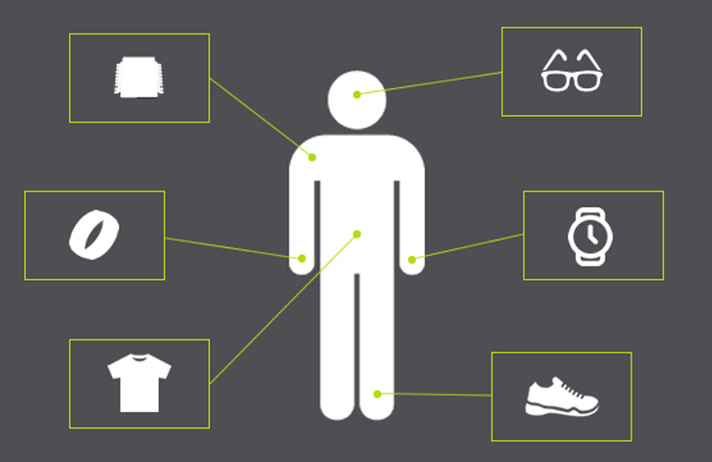
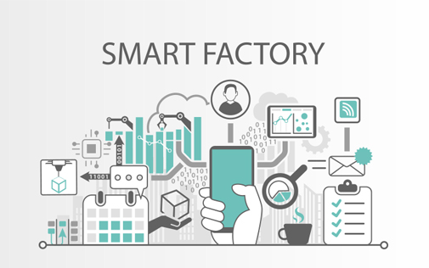
IoT (Internet of Things)
Connecting everyday things embedded with electronics, software & sensors to the internet & among themselves enabling them to collect & exchange data.
A “thing” is any object with embedded electronics that can transfer data over a network – without any human interaction. Same thing if capable of taking decisions on its own without any human intervention then thing could be also referred to a “Smart Thing”.
Examples are-
Wearable devices
Environmental sensors
Machinery in factories
Devices in homes
Components in vehicles

Slide 6
Agenda
1
IoT
2
Benefits & Architecture of IoT
3
Raspberry pi
4
Infineon & Raspberry pi in IoT
5
Components (Infineon)
6
Applications
1
Egg catcher game using Magnetic Sensor
2
Gesture recognition using Magnetic Sensor

Slide 7





Benefits of IoT
Efficient resource utilization
Minimizes human effort
Saves time
Benefits
Development of AI through IoT
Improved security

Slide 8

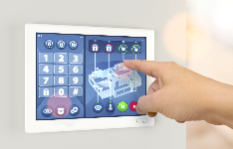
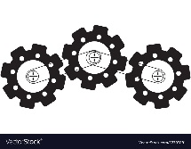

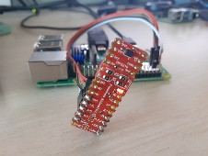
5 Layer architecture
Business Layer
Manages the whole IoT system, including applications, business & profit
models & users privacy.
Application Layer
Responsible for delivering application specific service to the user.
Processing Layer
Stores, analyses & process huge amount of data. Create databases,
cloud computing & big data processing modules.
Comm Layer
Transfer the sensor data between different layer through networks such
as wireless, 3G, LAN, Bluetooth, RFID & NFC.
Perception Layer
Sensors sense and gather information about the environment.

Slide 9
Agenda
1
IoT
2
Benefits & Architecture of IoT
3
Raspberry pi
4
Infineon & Raspberry pi in IoT
5
Components (Infineon)
6
Applications
1
Egg catcher game using Magnetic Sensor
2
Gesture recognition using Magnetic Sensor

Slide 10
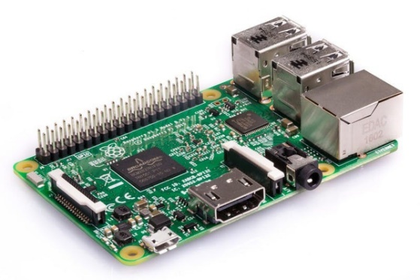
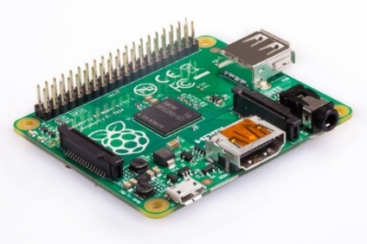
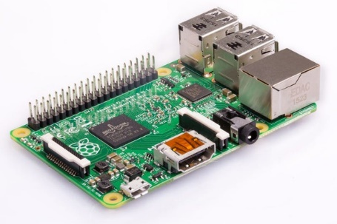
Raspberry Pi
The Raspberry Pi is a low cost, credit-card sized computer that plugs into a computer monitor or TV, and uses a standard keyboard and mouse.
Pi 1 Model A+
CPU: 700MHz 32-bit single-core ARMv6 RAM: 512MB** USB: 1 port Connectivity: None
Pi 2 Model B
CPU: 900MHz 32-bit quad-core ARMv8* RAM: 1GB USB: 4 ports Connectivity: Ethernet
Pi 3 Model B+
CPU: 1.2GHz 64-bit quad-core ARMv8 RAM: 1GB USB: 4 ports Connectivity: Ethernet, Wi-Fi, Bluetooth

Slide 11
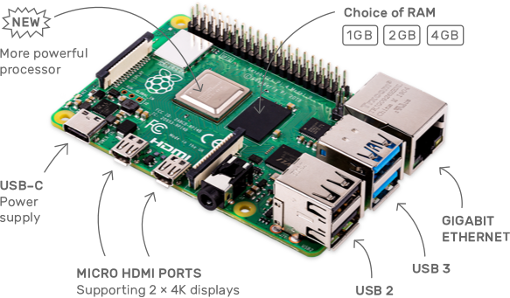
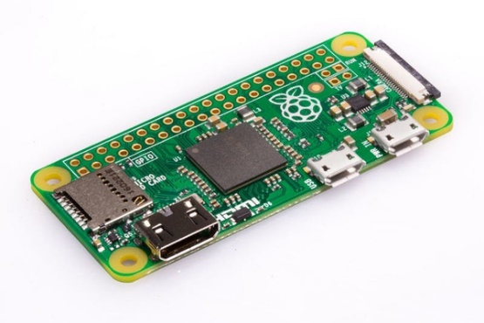
Raspberry Pi
Pi 4 Model B
CPU: Quad core Cortex-A72 (ARM v8) 64-bit SoC @ 1.5GHz
RAM: 1GB, 2GB or 4GB LPDDR4-3200 SDRAM (depending on model)
USB: 2 USB 3.0 ports; 2 USB 2.0 ports.
2 × micro-HDMI ports (up to 4kp60 supported)
Connectivity: 2.4 GHz and 5.0 GHz IEEE 802.11ac wireless, Bluetooth 5.0, BLE, Gigabit Ethernet
Pi Zero
CPU: 1GHz 32-bit single-core ARMv6 RAM: 512MB USB: 1 micro USB OTG port Connectivity: Bluetooth and Wi-Fi

Slide 12
Possibilities with Raspberry Pi
It is a capable little device that enables people of all ages to explore computing, and to learn how to program in languages like Scratch and Python.
It’s capable of doing everything you’d expect a desktop computer to do, from browsing the internet and playing high-definition video, to making spreadsheets, word-processing, and playing games.
Raspberry Pi has the ability to interact with the outside world with help of sensors connected to its 40 GPIO pins & DSI display port CSI camera port.
Has been used in a wide array of digital maker projects, from music machines and parent detectors to weather stations.

Slide 13
Agenda
1
IoT
2
Benefits & Architecture of IoT
3
Raspberry pi
4
Infineon & Raspberry pi in IoT
5
Components (Infineon)
6
Applications
1
Egg catcher game using Magnetic Sensor
2
Gesture recognition using Magnetic Sensor

Slide 14






Infineon & Raspberry Pi in IoT
Cloud gateway
Multi cloud supported
TCP, HTTP, Restful API
MQTT
Interact with outer atmosphere
Infineon industrial Grade sensor
DPS, TLV, Microphone
Raspberry pi Adapter
Software
Cloud connectivity
Hardware
Maker/ Industrial innovation
Application
Infineon
Offering
Edge processor
Media controller
Vision system
Data acquisition
Visualization
Controller
Python Libraries for Infineon Sensors
Application layer
Example codes for different sensors

Slide 15
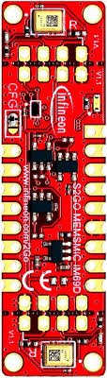
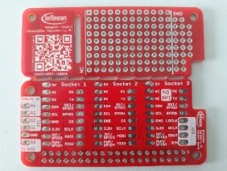
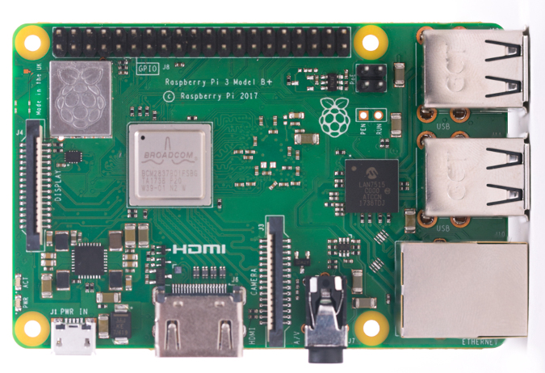


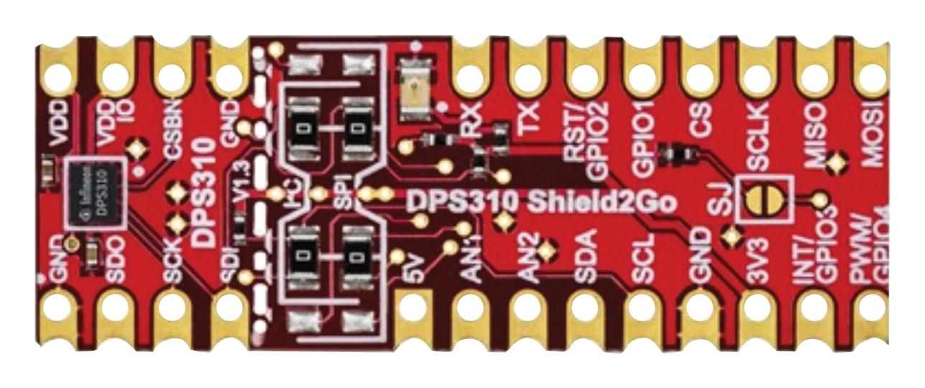
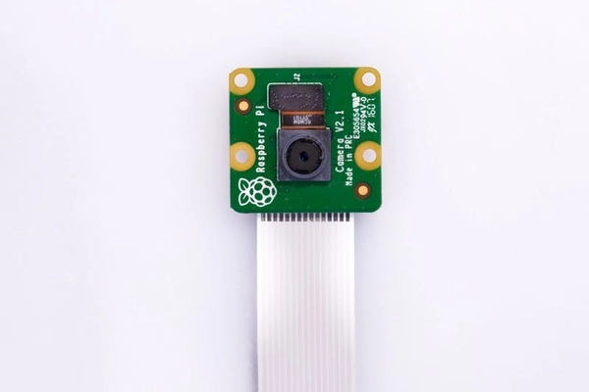
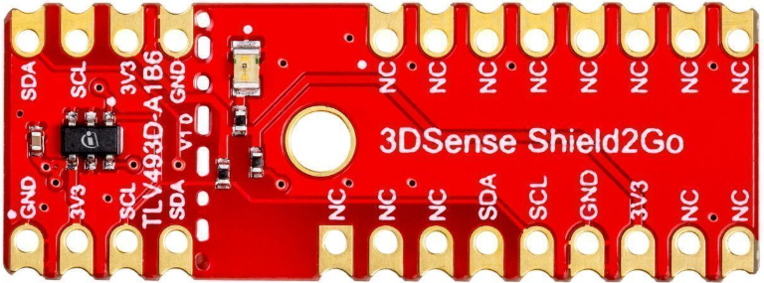
Hardware and software blocks of ecosystem(current)
Rpi
Rpi adapter & Camera
Infineon Sensors
Bringing the “Internet of Things” with Raspberry pi to life requires a comprehensive system approach, inclusive of –
Intelligent processing and sensing technology
Connectivity
Software & services
Along with a leading ecosystem of partners

Slide 16
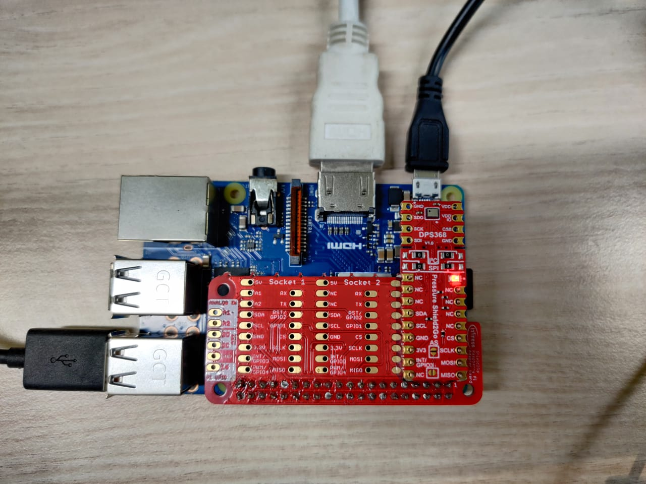
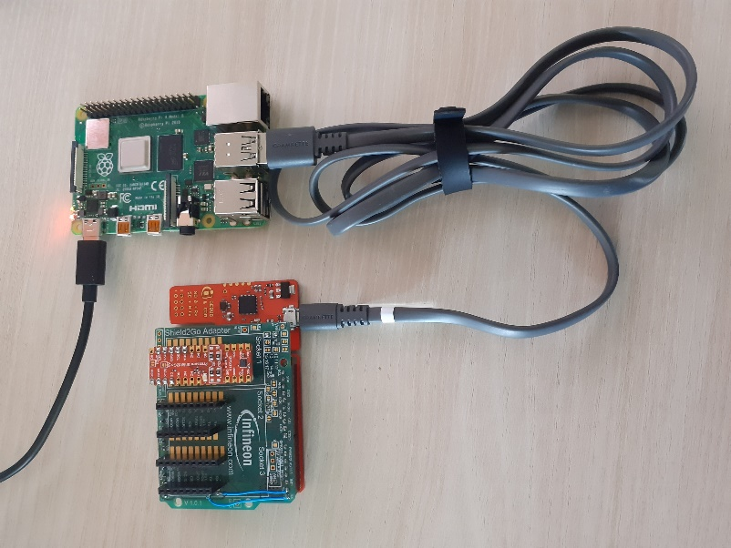
Benefit of using Raspberry pi
Solution after python libs
Solution before python Libs

Slide 17
Benefit of using Raspberry pi
Business Layer
Manages the whole IoT system, including applications, business & profit
models & users privacy.
Application Layer
Responsible for delivering application specific service to the user.
CLUBBED
Processing Layer
Stores, analyses & process huge amount of data. Create databases,
cloud computing & big data processing modules.
Transport Layer
Transfer the sensor data between different layer through networks such
as wireless, 3G, LAN, Bluetooth, RFID & NFC.
Perception Layer
Sensors sense and gather information about the environment.

Slide 18
Agenda
1
IoT
2
Benefits & Architecture of IoT
3
Raspberry pi
4
Infineon & Raspberry pi in IoT
5
Components (Infineon)
6
Applications
1
Egg catcher game using Magnetic Sensor
2
Gesture recognition using Magnetic Sensor

Slide 19
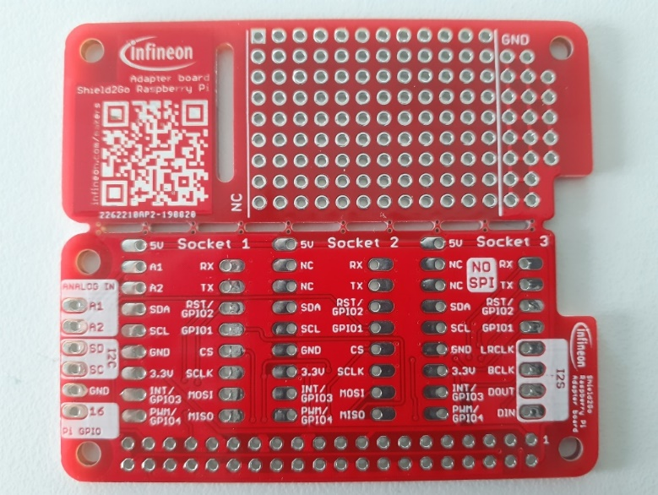
Shield2Go Adapter for Raspberry Pi
To be stacked on the top of raspberry pi, making pi compatible with S2Go format.
Compatible with Raspberry pi 3, 3B+, 4B and Zero.
Link

Slide 20
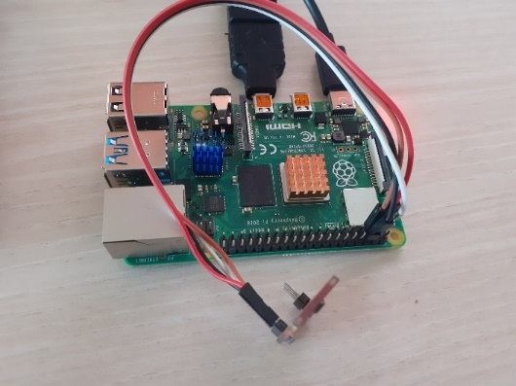


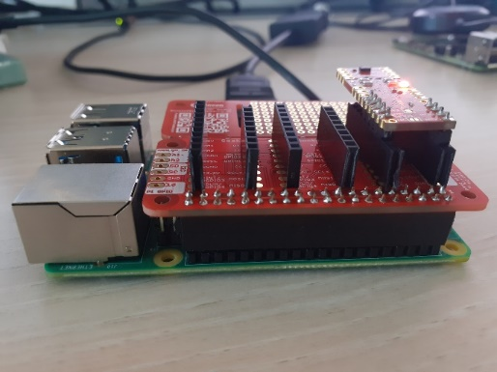
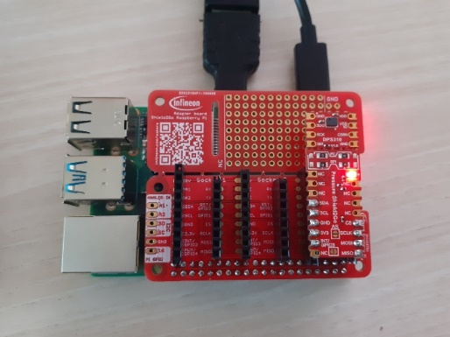

Advantage of Adapter
Hassle of wires lead to multiple problems.
Avoid usage of wires and avoids loose connection.
Multiple sensors can be stacked at same time.

Slide 21
Sensors compatible with Raspberry pi
DPS 310, 368, 422 -- Digital Pressure Sensor (GitHub Link)
TLV493D -- Magnetic Sensor (GitHub Link)
IM69D130 -- MEMS Microphone (GitHub Link)

Slide 22
Agenda
1
IoT
2
Benefits & Architecture of IoT
3
Raspberry pi
4
Infineon & Raspberry pi in IoT
5
Components (Infineon)
6
Applications
1
Egg catcher game using Magnetic Sensor
2
Gesture recognition using Magnetic Sensor

Slide 23
Agenda
1
IoT
2
Benefits & Architecture of IoT
3
Raspberry pi
4
Infineon & Raspberry pi in IoT
5
Components (Infineon)
6
Applications
1
Egg catcher game using Magnetic Sensor
2
Gesture recognition using Magnetic Sensor

Slide 24

Egg catcher game

Slide 25
Agenda
1
IoT
2
Benefits & Architecture of IoT
3
Raspberry pi
4
Infineon & Raspberry pi in IoT
5
Components (Infineon)
6
Applications
1
Egg catcher game using Magnetic Sensor
2
Gesture recognition using Magnetic Sensor

Slide 26
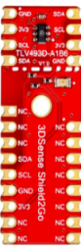
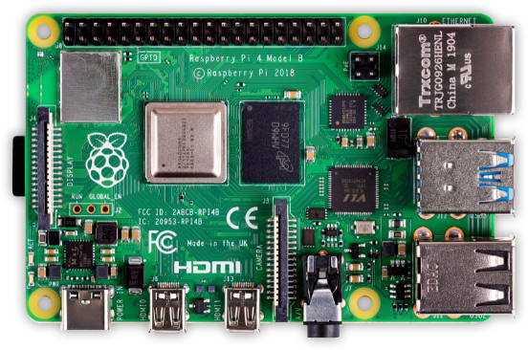
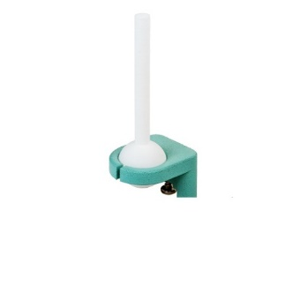
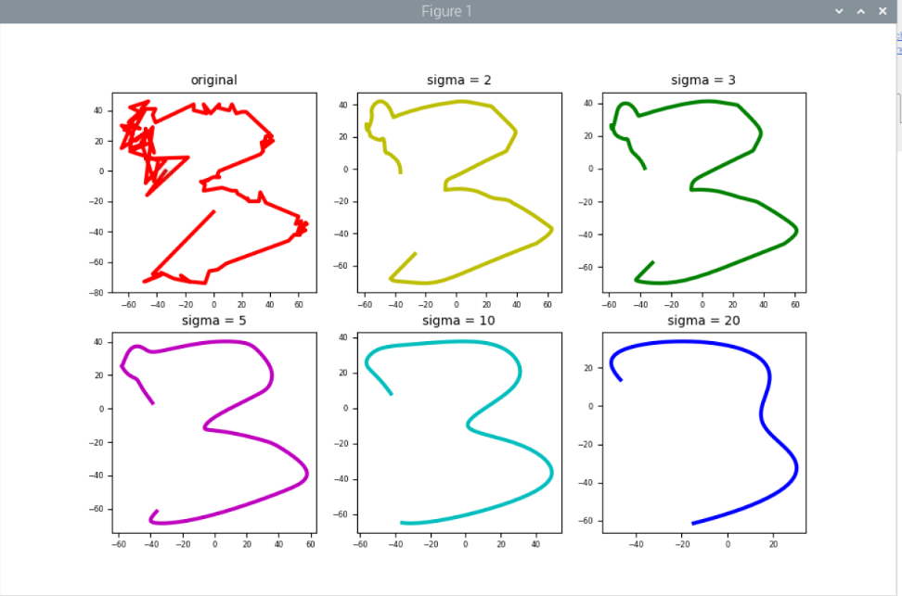
Gesture recognition
Raw data
to 2D
co-ordinates
3DSense Shield2Go
Gaussian Filter

Slide 27
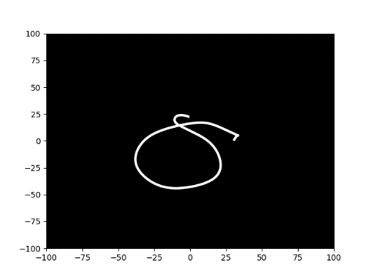
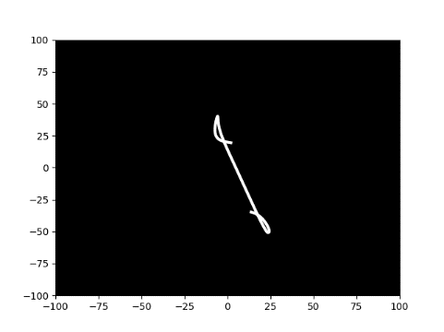
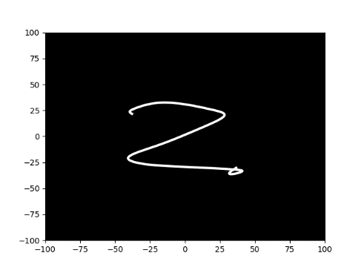
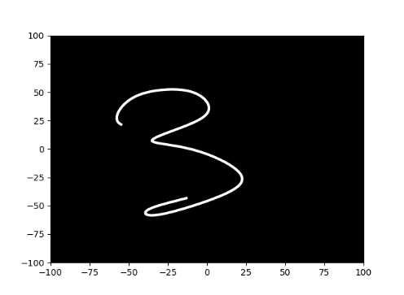
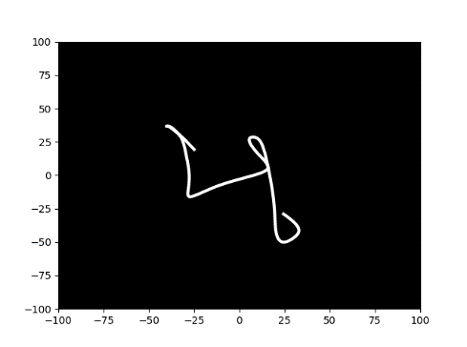
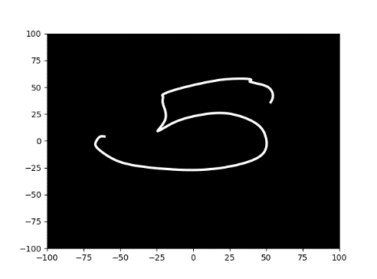
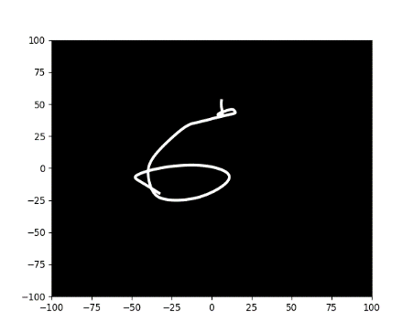
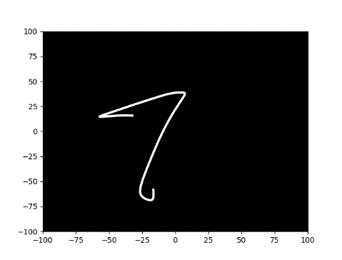
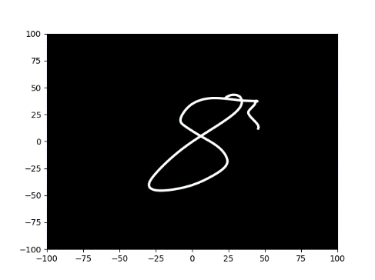
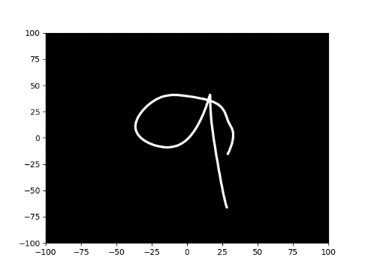
Output

Slide 28
Agenda
3
Detecting wind speed using 2 barometric Pressure Sensor
4
Platform for exchanging knowledge

Slide 29
Wind speed measurement with two barometric Pressure sensors
Sensor A measures the barometric air pressure inside the device. The Sensor needs to be protected from the wind, but the device must not be completely air tight.
Sensor B measures the air pressure facing to the wind
The wind speed can be calculated with the air pressure values of sensor A and B
Device
Sensor A
Sensor B
Wind

Slide 30
Agenda
3
Detecting wind speed using 2 barometric Pressure Sensor
4
Platform for exchanging knowledge

Slide 31

Gitter
A platform for everyone to share their learnings & ideas related to that product.
While realizing any idea if one person faces the problem and he shares the it in chat other may help the person, that will save a lot of time and will enhance the maker culture IFIN & IFX wide.
Chat option will be available in the readme section of the repository in Infineon GitHub.

Slide 32
Important links
GitHub link - https://github.com/Infineon
Python lib for DPS - https://github.com/Infineon/RaspberryPi_DPS
Chat room link for DPS - https://gitter.im/MakerConerFor_DPS/community?utm_source=badge&utm_medium=badge&utm_campaign=pr-badge
Python lib for TLV - https://github.com/Infineon/RaspberryPi_TLV
Chat room link for TLV - https://gitter.im/MakerConerFor_TLV493D/community?utm_source=badge&utm_medium=badge&utm_campaign=pr-badge
MEMS microphone – https://github.com/Infineon/GetStarted_IM69D130_With_RaspberryPi
Confluence link - http://confluencewikiprod.intra.infineon.com/pages/viewpage.action?pageId=190789474
Notes:
Avoid abbreviation

Slide 33


